Slide 1
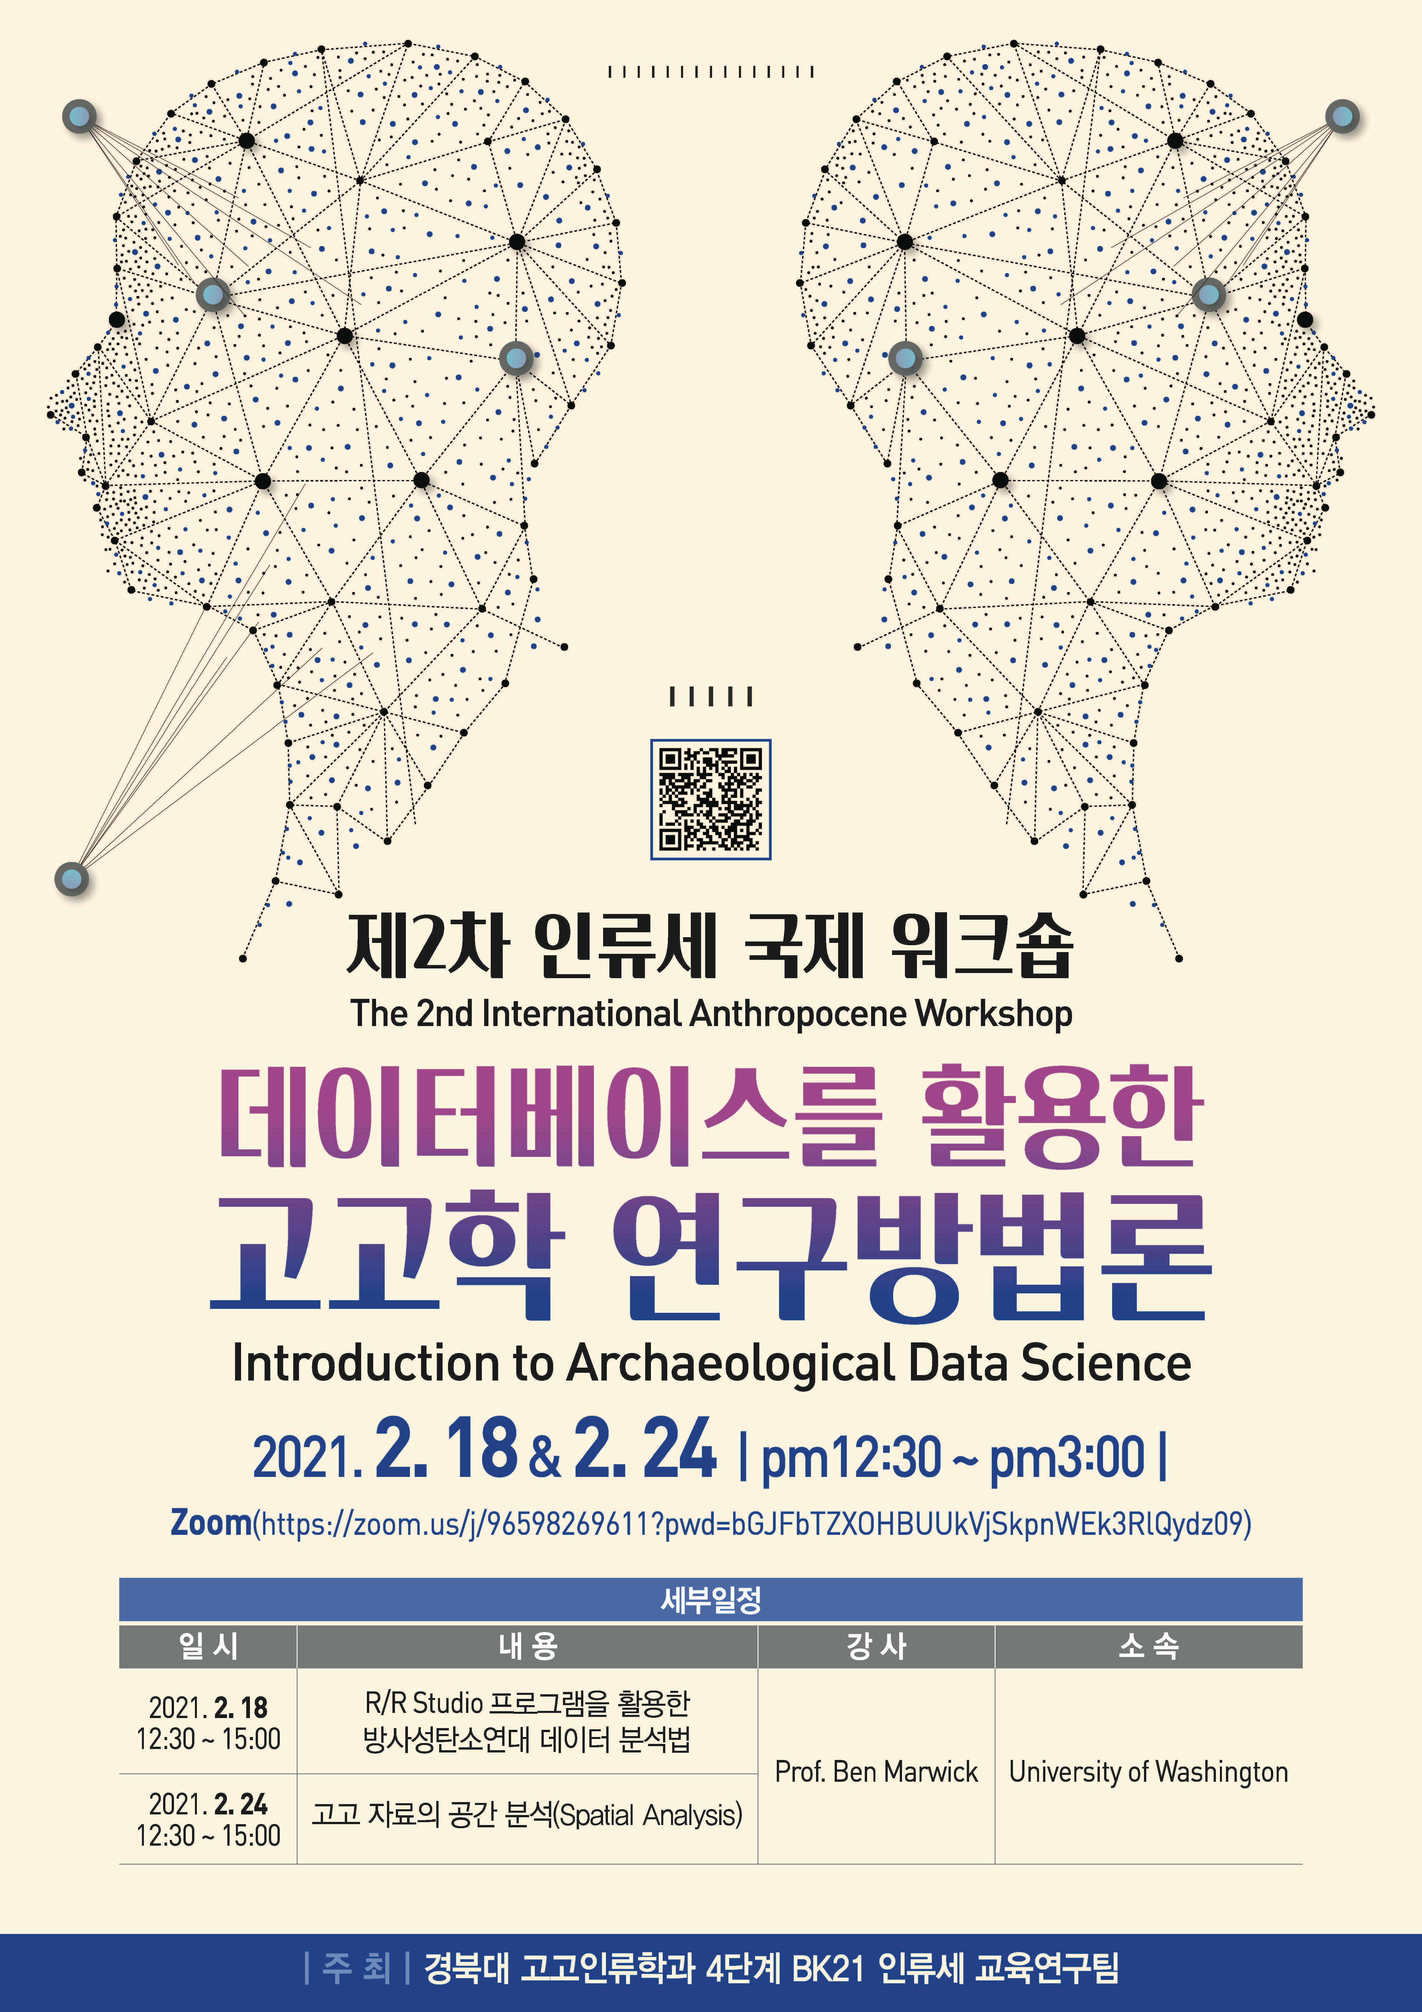
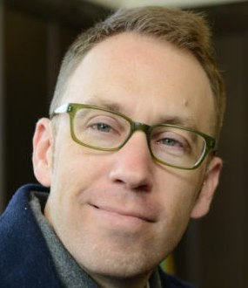
Analysing Archaeological Radiocarbon Ages Using R
Ben Marwick
University of Washington
@benmarwick

Slide 2
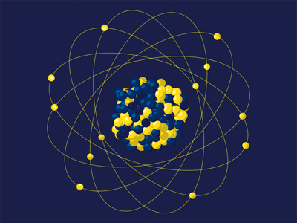
Radiocarbon dating

Slide 3
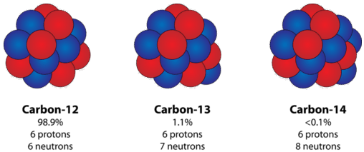
What is an isotope?
Some are radioactive

Slide 4
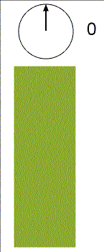
Half-life: the time it takes for the radioactivity of an isotope to fall to half its original value

Slide 5
Half-life: this substance has a half-life of about one second

Slide 6
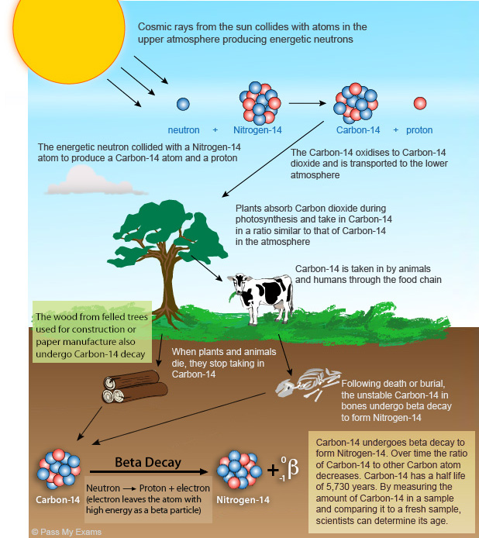

Slide 9
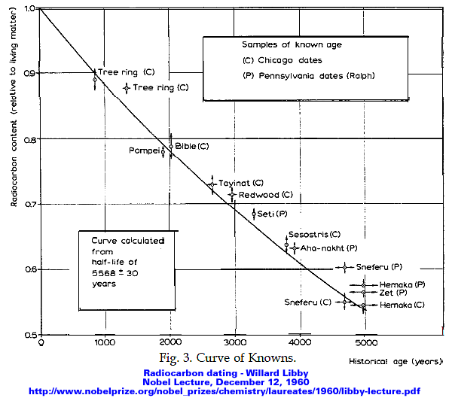
Notes:
the “Curve of Knowns.” This graph compared the known age of artifacts with the estimated age as determined by the radiocarbon dating method.

Slide 10
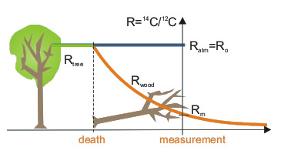
Conventional radiocarbon age is determined after comparison of 14C/12C in the sample and in the standard of modern biosphere

Slide 11
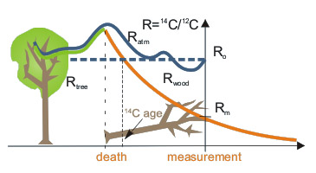
However, during the last 50 thousand years, atmospheric 14C concentration was usually higher than in the modern biosphere, and radiocarbon age is usually younger than the calendar age of the sample
Notes:
https://radiocarbon.pl/en/radiocarbon-dating/

Slide 12
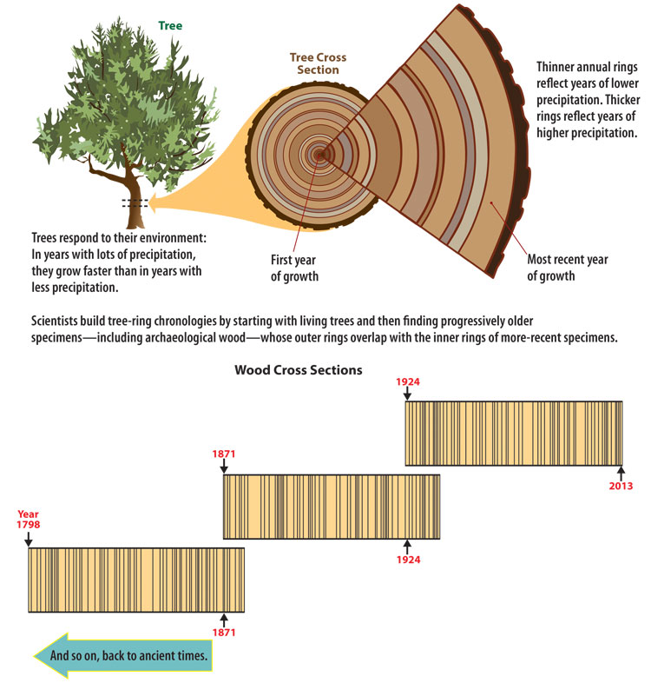

Slide 13
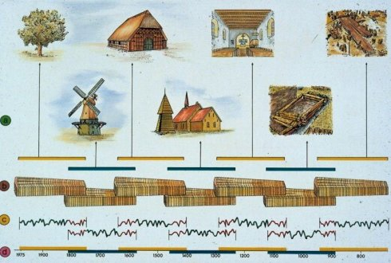

Slide 14
Input: Calibration curve from dating and counting tree rings
Input: Age from count of 14C
Output: Calendar years before the present (1950)

Slide 15
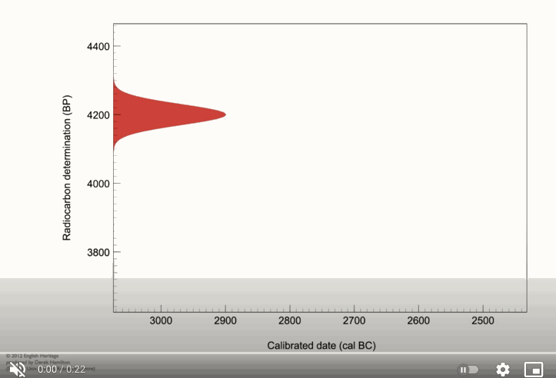
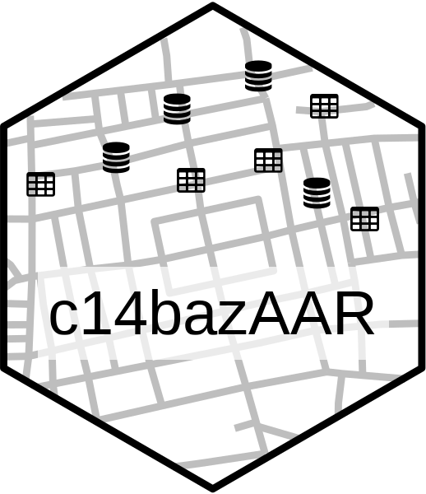

We are going to use R to calibrate radiocarbon ages for a selection of Egyptian pyramids

Slide 16
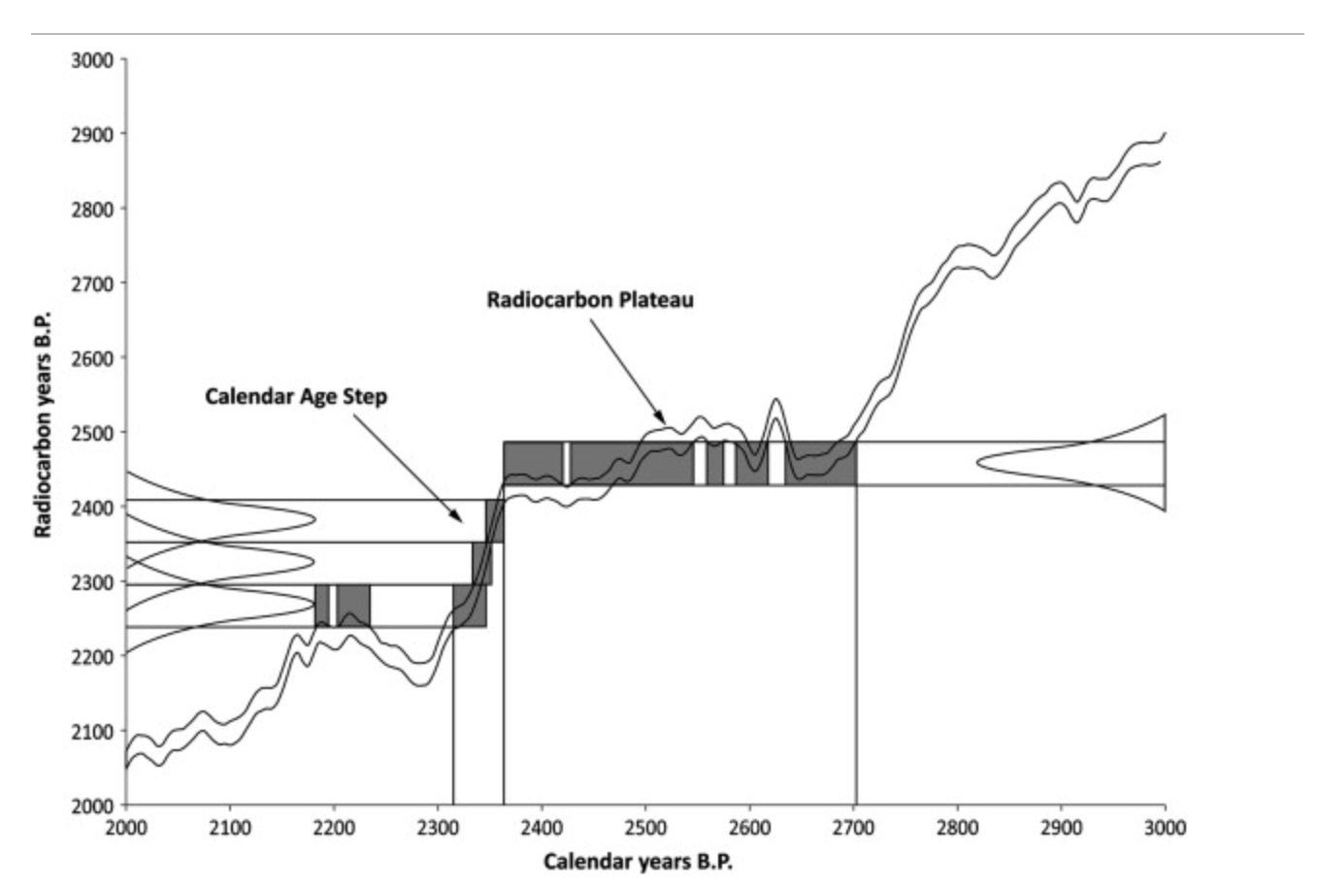
Limitations of radiocarbon dating accuracy due to the calibration process
Notes:
https://www-sciencedirect-com.offcampus.lib.washington.edu/science/article/pii/S0305440311002482

Slide 17
Limitations of radiocarbon dating accuracy due to the calibration process
😒 different ages calibrate to the same calendar year range
Notes:
https://www-sciencedirect-com.offcampus.lib.washington.edu/science/article/pii/S0305440311002482

Slide 18
Limitations of radiocarbon dating accuracy due to the calibration process
😒 one age calibrates to a very wide calendar year range
😒 different ages calibrate to the same calendar year range
Notes:
https://www-sciencedirect-com.offcampus.lib.washington.edu/science/article/pii/S0305440311002482

Slide 19
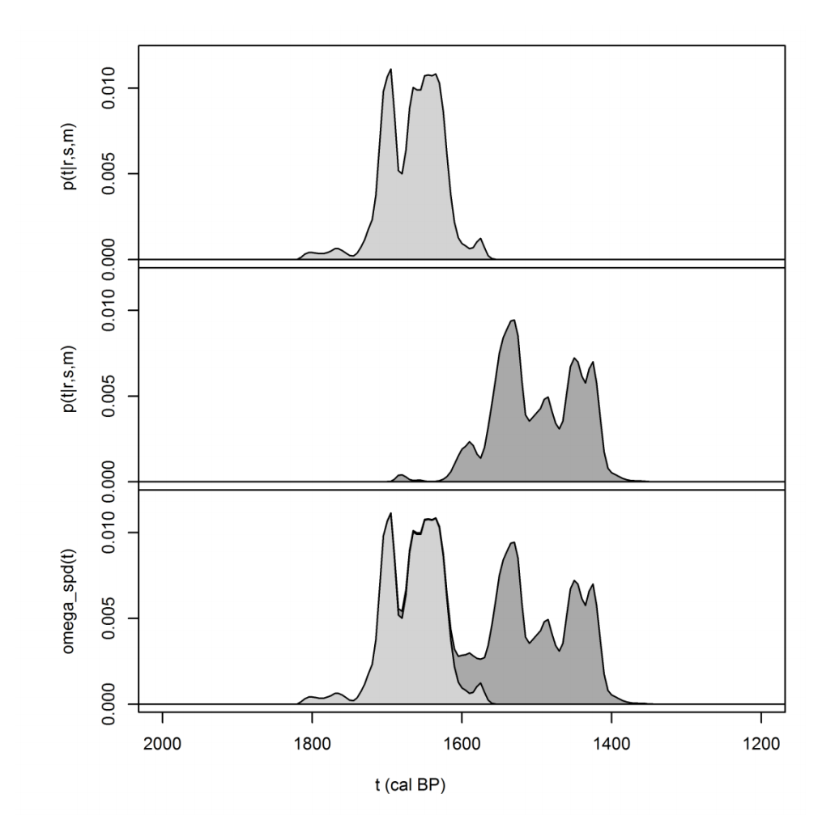

Summed probability distribution: Combining radiocarbon ages to identify periods of more or less activity.
We are going to compute a summed probability distribution to find out the main period of pyramid building

Slide 20
What are we going to do?
Calibrate radiocarbon ages
Non-parametric phase estimation in a set of ages
Age-depth modelling, e.g. for several ages from one excavation
Summed probability distribution, e.g. for regional palaeodemographic analysis
Hypothesis testing

